Slide 1


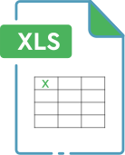

UBER SUPPLY DEMAND GAP
Analyzed Uber ride request data to uncover demand supply gaps and peak hour inefficiencies.
Used Excel, SQL, and Python for data cleaning, visualization, and insight generation to support operational improvements.
Presented by
Karthik Doguparthi

Slide 2
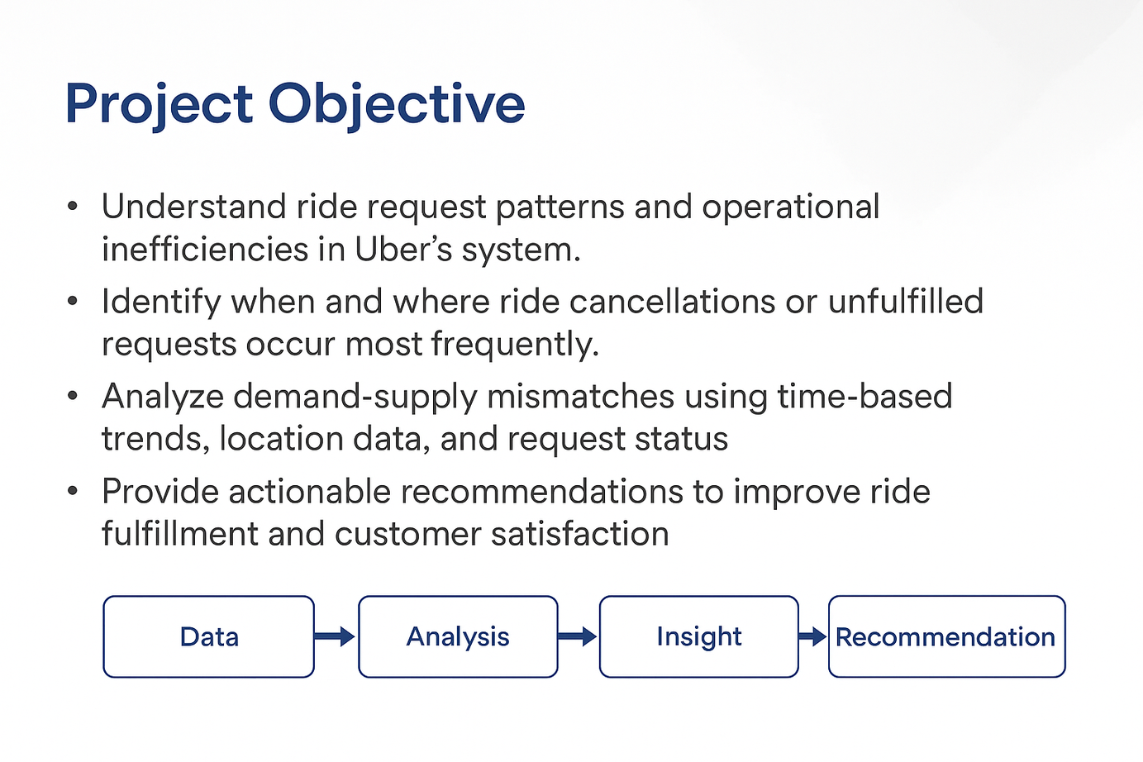
Project Objective
To understand ride request patterns and operations in the Uber ride system.
Identify the demand supply relationship at the pickup location.
Analyse the most travelled time of the day for accuracy.
Recommendations to improve the customer satisfaction.

Slide 3
About the Dataset
The dataset contains 6,745 ride requests provided by Uber.
Includes columns like request ID, timestamps, pickup point, driver ID, status, and distance.
Covers various ride outcomes such as Trip Completed, Cancelled, and No Cars Available.
The original file was cleaned in Excel, handling with missing values.
Created new columns like Day category, Travel time for analysis and insights.

Slide 4
Data cleaning
Performed data cleaning using Excel.
Changed the mixed date type in columns to short date type.
Split request timestamp and drop timestamp columns to date and time using a delimiter.
Created a column to find the category of day when pickup is requested.
New calculated column travel time is created to find how long are the rides requested for.
New calculated column is derived from travel time to show the kind of distance (Near/Far).

Slide 5
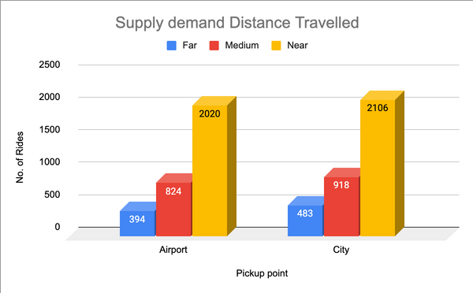
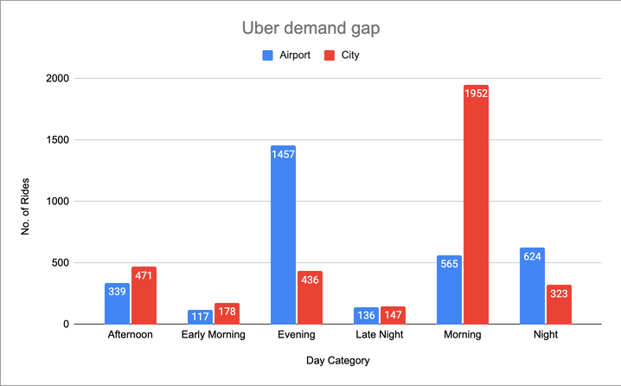
Dashboards
Fig 1 shows the supply of uber for the distance travelled.
Fig 2 shows demand of uber at pickup points by day category.
Fig 1
Fig 2

Slide 6
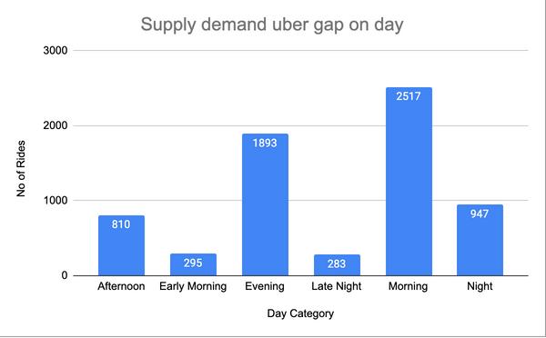
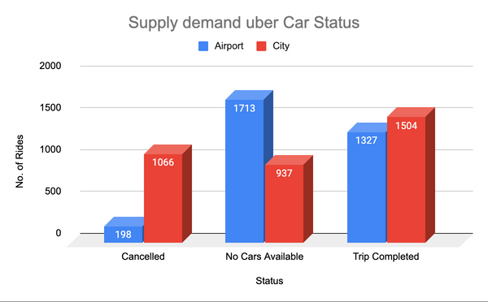
Dashboards
Fig 3 shows the demand of total bookings per the type of day.
Fig 4 shows supply of booking status from pickup location.
Fig 3
Fig 4

Slide 7
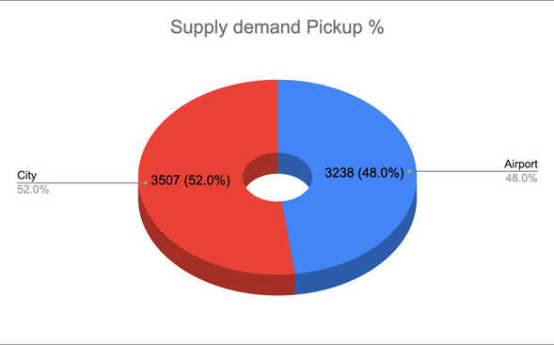
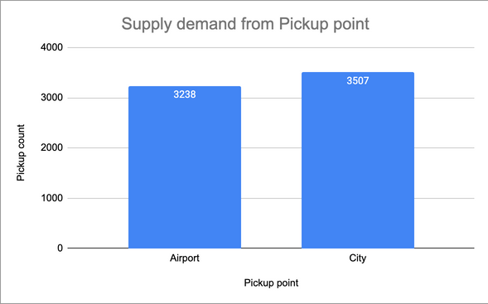
Dashboards
Fig 5 shows supply percentage of drivers from pickup point.
Fig 6 shows count of supply of drivers from pickup point
Fig 5
Fig 6

Slide 8
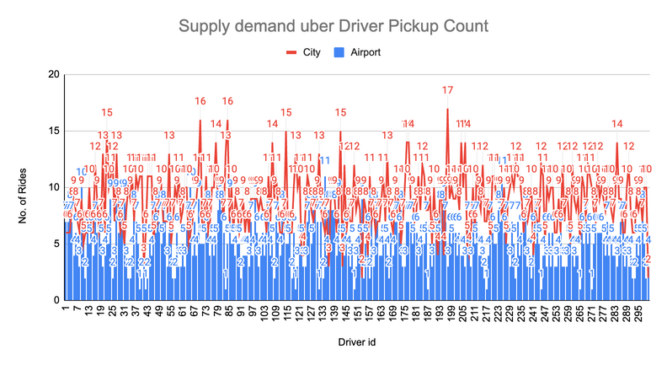
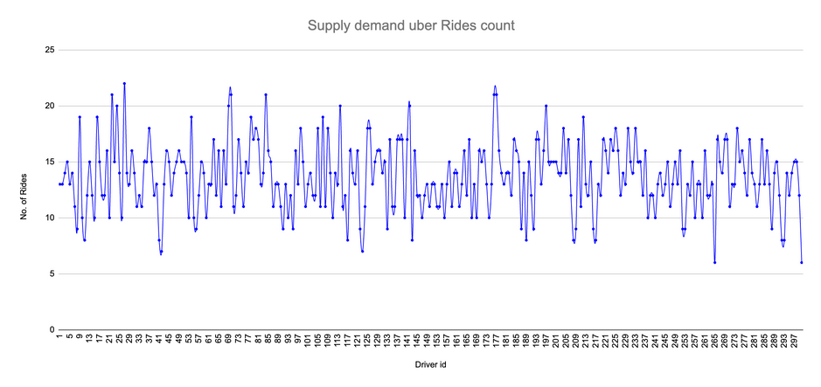
Dashboards
Fig 7 shows supply of rides wrt driver id.
Fig 8 shows supply of booking status from pickup location.
Fig 7
Fig 8

Slide 9
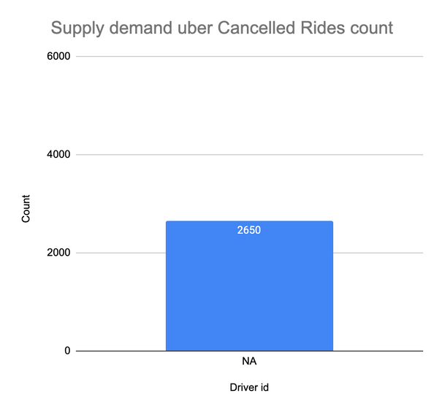
Dashboards
Fig 9 shows the demand for drivers at both the airport and the city.
Fig 9

Slide 10
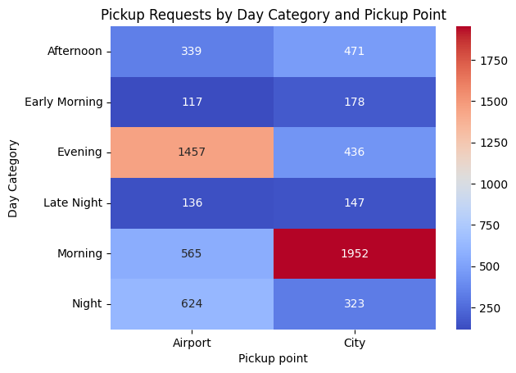
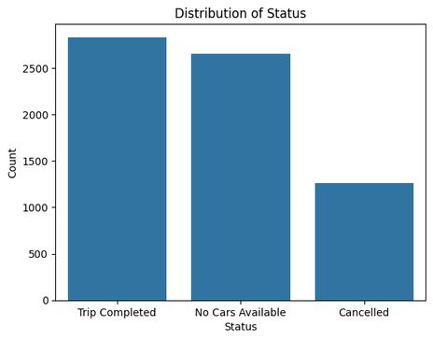
Exploratory Data Analysis in Colab
Fig 10 shows supply and demand for uber drivers.
Fig 11 show the demand of uber drivers at airport and city wrt day category.
Fig 4
Fig 10
Fig 11

Slide 11
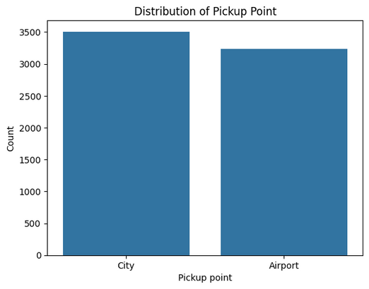
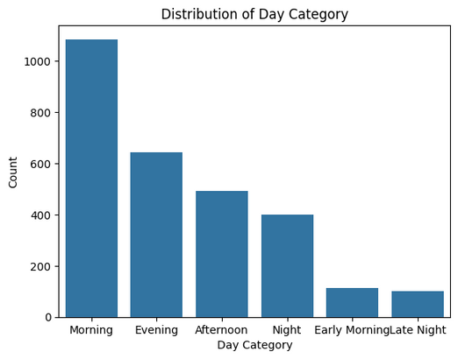
Exploratory Data Analysis in Colab
Fig 12 shows the supply of uber drivers at airport and city.
Fig 13 shows the demand of drivers wrt day category.
Fig 12
Fig 13

Slide 12
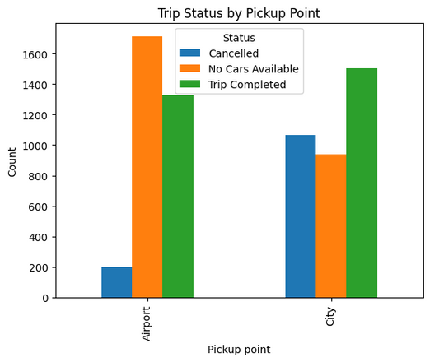
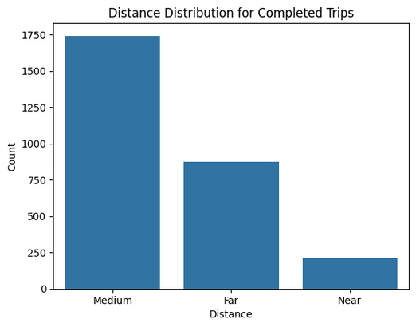
Exploratory Data Analysis in Colab
Fig 14 shows the supply of uber drivers for various distances.
Fig 15 shows the demand of uber at airport and city.
Fig 14
Fig 15

Slide 13
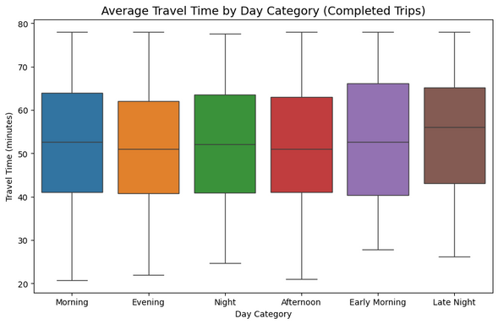
Exploratory Data Analysis in Colab
Fig 16 shows demand of drivers for avg travel time wrt day category.
Fig 17 shows demand comarison btw all day categories at pickup.
Fig 4
Fig 16
Fig 17

Slide 14
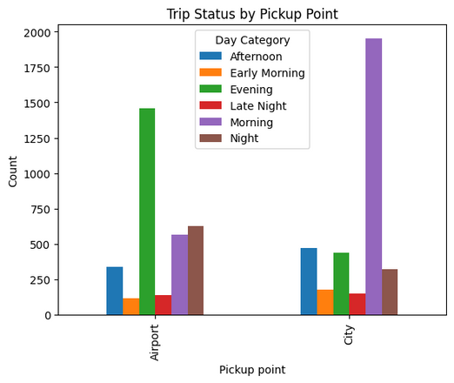
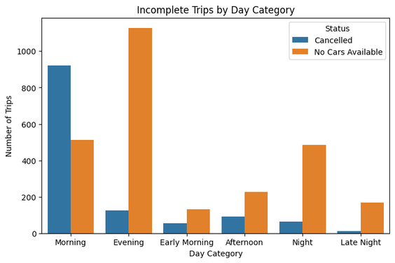
Exploratory Data Analysis in Colab
Fig 18 shows demand of Uber for drivers wrt day category.
Fig 19 shows demand of uber drivers at pickup wrt day category.
Fig 18
Fig 19

Slide 15
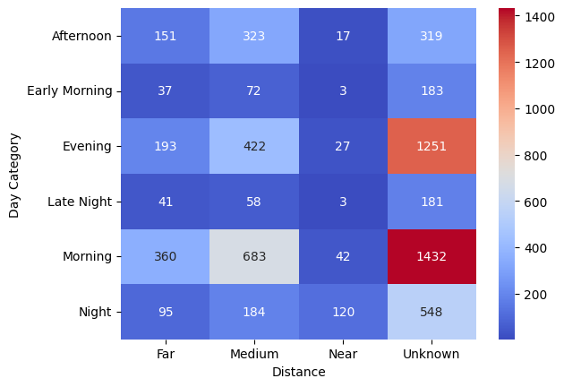
Exploratory Data Analysis in Colab
Fig 18 shows demand of Uber for drivers wrt day category.
Fig 19 shows supply and demand of uber drivers for distance wrt day category.
Fig 18
Fig 19

Slide 16
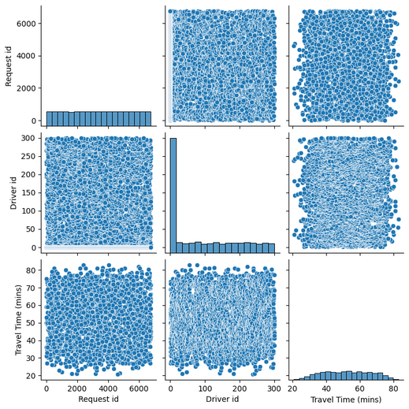
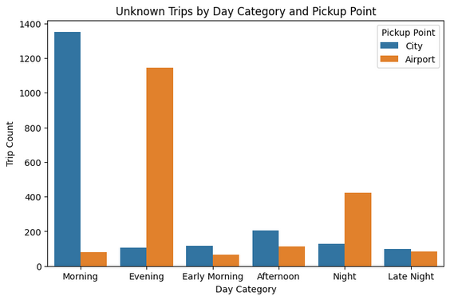
Exploratory Data Analysis in Colab
Fig 20 shows demand of Uber for drivers from pickup wrt day category
Fig 21 shows demand of uber drivers at pickup wrt day travel time.
Fig 20
Fig 21

Slide 17
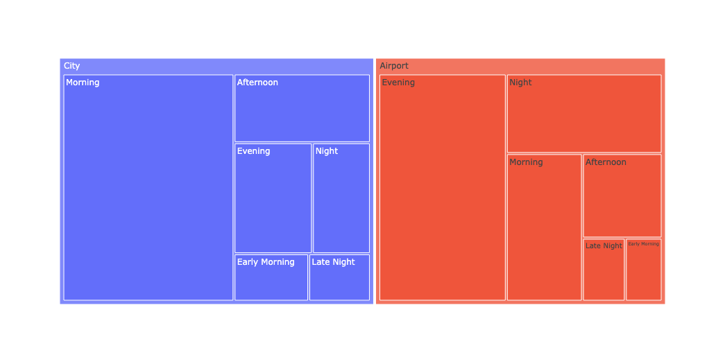
Exploratory Data Analysis in Colab
Fig 22 shows the treemap of the relationship between the bookings from pickup location wrt each other.
Fig 22

Slide 18
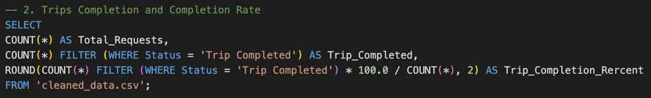

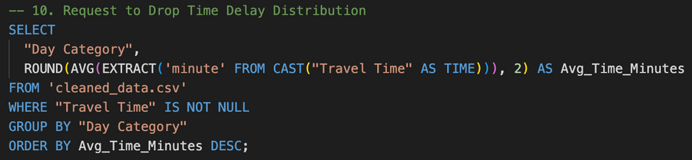
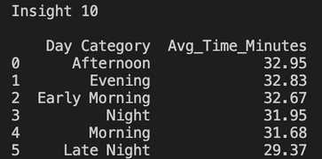
SQL Insights
Fig 22 and 23 gives insight about supply of Uber drivers to complete trips.
Fig 22
Fig 23
Fig 24 and 25 gives insight about the average travel time wrt categories of the day.
Fig 24
Fig 25

Slide 19
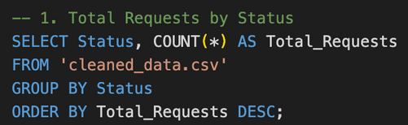
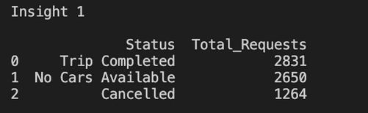
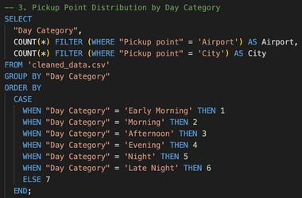
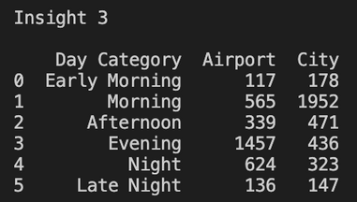
SQL Insights
Fig 26 and 27 gives insight about the supply of Uber drivers from airport and city.
Fig 26
Fig 27
Fig 28 and 29 gives insight about the demand of Uber driver from airport and city.
Fig 28
Fig 29

Slide 20
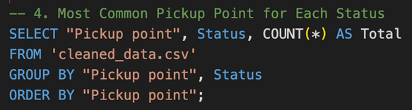
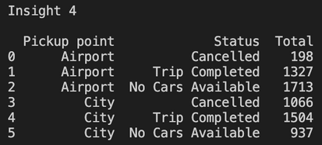
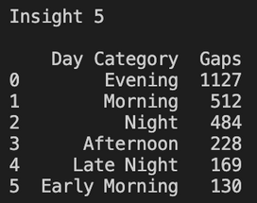
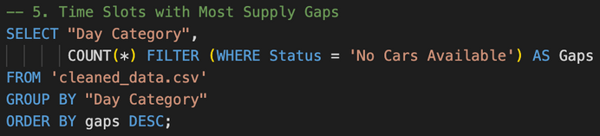
SQL Insights
Fig 30 and 31 gives insight about the demand of Uber drivers at airport and city.
Fig 30
Fig 31
Fig 32 and 33 gives insight about the demand of Uber driver wrt day category.
Fig 32
Fig 33

Slide 21
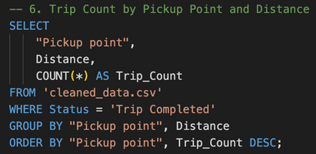
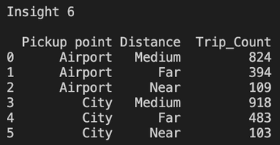
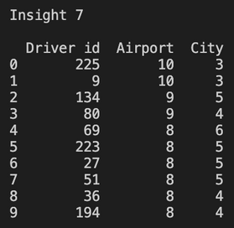
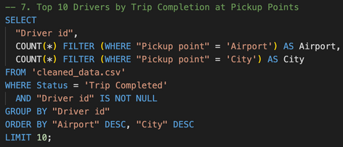
SQL Insights
Fig 34 and 35 gives insight about the demand of Uber drivers wrt travelling distances.
Fig 34
Fig 35
Fig 36 and 37 gives insight about the demand of top 10 Uber drivers at pickup points.
Fig 36
Fig 37

Slide 22
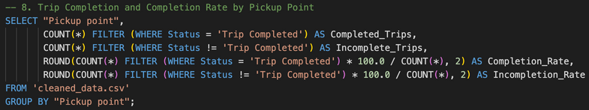

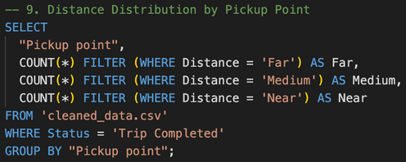
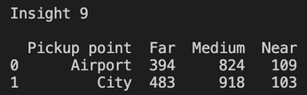
SQL Insights
Fig 38 and 39 gives insight about the supply and demand of Uber drivers at airport and city.
Fig 38
Fig 39
Fig 40 and 41 gives insight about the demand of Uber drivers wrt distance travelled.
Fig 40
Fig 41

Slide 23
Solution
Deploying more drivers at airport can reduce trip cancellation and increase the availability of cars.
Provide coupons for clients who travel more often and median of travel time.
Give incentive for drivers who are working during the peak hours.
Implement cancellation charges(during peak hours) to reduce the number of cancellations.
Providing incentive for night rides can likely increase number of drivers.

Slide 24
Conclusion
The goal was to understand Uber ride pattern using real time data.
Cleaned and transformed data using Excel.
Performed EDA in Colab.
Found insights using SQL via VS Code.
Built pivot tables, dashboards in Excel and visualizations in Colab.
Delivered key solutions which will help Uber to increase business.

